Slide 1






Faculty of Industrial Technology
Faculty of Infrastructure Planning
YOUR PAPER TITLE HERE
Presenter Name¹, Co-author Name², Co-author Name¹
¹Affiliation, ²Affiliation
Paper ID 000
IC
-SEID
2026
The 3rd Biennial International Conference on Sustainable Engineering, Infrastructure, and Development
*Engineering Innovation for Energy Transition, Climate Resilience, and Sustainable Development*
November 11-12, 2026 – Bidakara Hotel Jakarta
icoseid.universitaspertamina.ac.id
icoseid@universitaspertamina.ac.id
icoseid_uper
Notes:
[0:00–0:30 · 30 s] Greet the chair and audience. State your name, affiliation, and the paper title in one sentence.

Slide 2

Faculty of Industrial Technology
Faculty of Infrastructure Planning
OUTLINE
01
BACKGROUND
04
RESULTS
02
GAP & OBJECTIVES
05
DISCUSSION
03
METHODOLOGY
06
CONCLUSION
ICO-SEID 2026
rd
The 3 Biennial International Conference on Sustainable Engineering,
Infrastructure, and Development
icoseid.universitaspertamina.ac.id
icoseid@universitaspertamina.ac.id
icoseid_uper
Notes:
[0:30–0:50 · 20 s] Briefly preview the six parts. Do not read every item.

Slide 3

Faculty of Industrial Technology
Faculty of Infrastructure Planning
BACKGROUND
Context: why this topic matters globally and in Indonesia, with one key figure or statistic.
Current practice: how the problem is handled today in the study area.
Problem: the specific issue this paper addresses, in one sentence.
Relevance: how solving it supports sustainable engineering, infrastructure, or development.
icoseid.universitaspertamina.ac.id
icoseid@universitaspertamina.ac.id
icoseid_uper
Notes:
[0:50–1:50 · 1 min] Set the context with one strong number, then narrow down to the specific problem.

Slide 4

Faculty of Industrial Technology
Faculty of Infrastructure Planning
GAP & OBJECTIVES
STATE OF THE ART
What is missing and what this study aims to do
01
What key previous studies have already done.
RESEARCH GAP
02
What is still missing or unresolved in the literature.
OBJECTIVE 1
03
First aim of this study, stated as a measurable target.
OBJECTIVE 2
04
Second aim of this study, stated as a measurable target.
NOVELTY
05
What is new: method, data, location, or application.
icoseid.universitaspertamina.ac.id
icoseid@universitaspertamina.ac.id
icoseid_uper
Notes:
[1:50–2:50 · 1 min] Show what has been done, the gap, and your objectives. End with the novelty — this is what reviewers listen for.

Slide 5

Faculty of Industrial Technology
Faculty of Infrastructure Planning
METHODOLOGY
Data, methods, and analysis steps
01
Step
01
Step
02
Step
03
Step
04
Step
05
Step
06
DATA
PROCESSING
MODELLING
ANALYSIS
VALIDATION
EVALUATION
Sources, location, period, and sample size
Cleaning, screening, and data preparation
Method, model, or framework applied
Scenarios, calculations, or simulations
Comparison with field data or literature
Criteria or indicators used to judge results
icoseid.universitaspertamina.ac.id
icoseid@universitaspertamina.ac.id
icoseid_uper
Notes:
[2:50–4:20 · 1.5 min] Walk through the workflow left to right. Rename or remove steps to match your study; 4–6 steps is ideal.

Slide 6
Faculty of Industrial Technology
Faculty of Infrastructure Planning
RESULTS
Key findings in table and figures
 | Baseline | Scenario 1 | Scenario 2 | Scenario 3 | Change (%)
Parameter 1 (unit)
Parameter 2 (unit)
Parameter 3 (unit)
icoseid.universitaspertamina.ac.id
icoseid@universitaspertamina.ac.id
icoseid_uper
Notes:
[4:20–5:50 · 1.5 min] Highlight only the 1–2 most important numbers. Resize the table to your data; keep it to ≤5 rows.

Slide 7
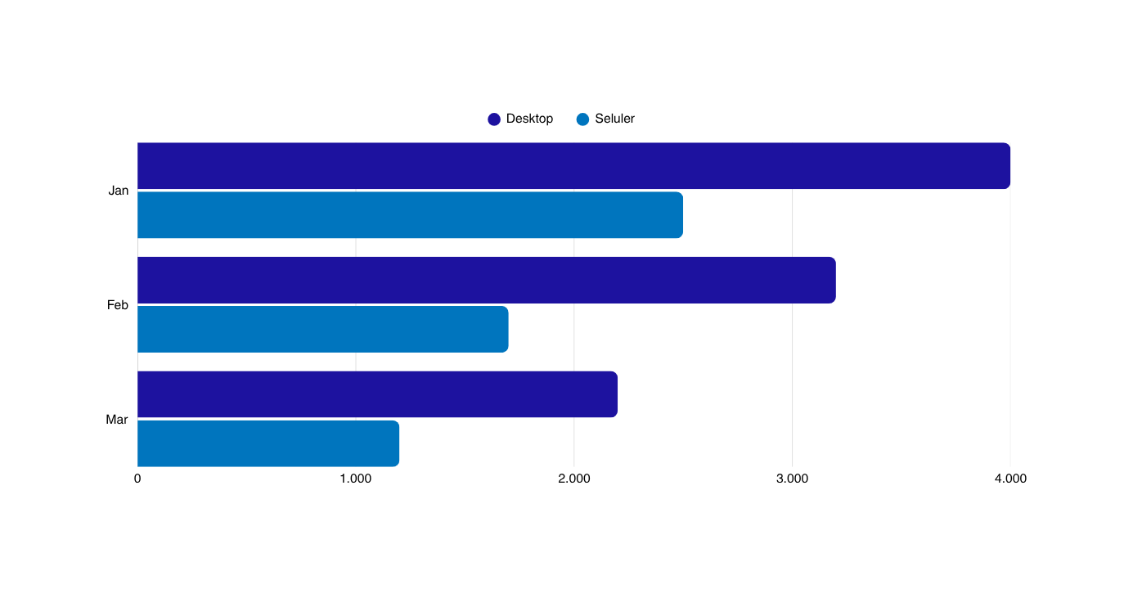
Faculty of Industrial Technology
Faculty of Infrastructure Planning
MAIN FINDINGS
01
icoseid.universitaspertamina.ac.id
icoseid@universitaspertamina.ac.id
icoseid_uper
Notes:
[5:50–7:20 · 1.5 min] Replace the sample chart with your main figure (right-click › Change Picture). State the takeaway before explaining the axes.

Slide 8

Faculty of Industrial Technology
Faculty of Infrastructure Planning
DISCUSSION
Interpretation: what the results mean and the mechanism or trend behind them.
Comparison: how the findings agree or differ with previous studies, and why.
Implications: practical value for industry, policy makers, or communities.
Limitations: assumptions, data constraints, and scope of this study.
01
icoseid.universitaspertamina.ac.id
icoseid@universitaspertamina.ac.id
icoseid_uper
Notes:
[7:20–8:30 · ~1 min] Explain why the results look this way and compare with 1–2 key references.

Slide 9
Faculty of Industrial Technology
Faculty of Infrastructure Planning
CONCLUSION
Finding 1: answer to Objective 1, stated with the key number.
Finding 2: answer to Objective 2, stated with the key number.
Contribution: what this study adds to sustainable engineering, infrastructure, and development.
Future work: the next step to extend or validate this research.
icoseid.universitaspertamina.ac.id
icoseid@universitaspertamina.ac.id
icoseid_uper
icoseid.universitaspertamina.ac.id
icoseid@universitaspertamina.ac.id
icoseid_uper
Notes:
[8:30–9:30 · 1 min] One finding per objective, with numbers. Finish with future work.

Slide 10

Faculty of Industrial Technology
Faculty of Infrastructure Planning
THANK YOU
QUESTIONS & DISCUSSION
ICO-SEID 2026
rd
The 3 Biennial International Conference on Sustainable Engineering,
Infrastructure, and Development
icoseid.universitaspertamina.ac.id
icoseid@universitaspertamina.ac.id
icoseid_uper
Notes:
[9:30–10:00 · 30 s] Thank the audience and invite questions.

